Slide 1
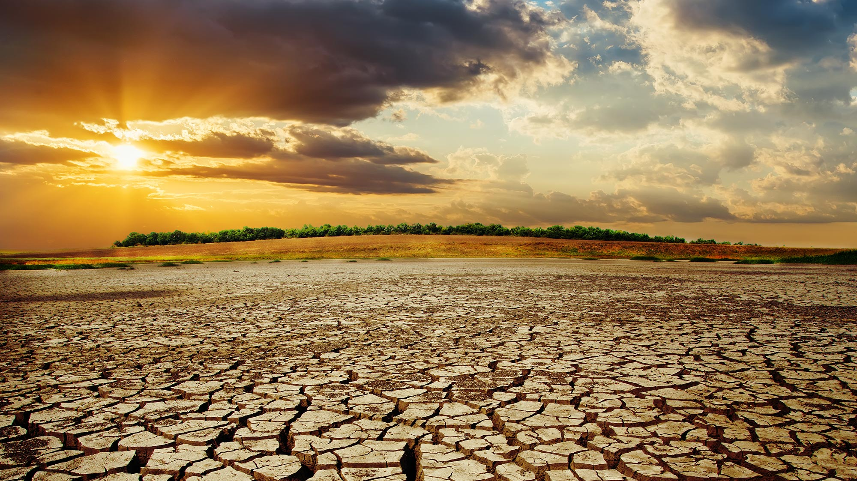
What effects does the climate changes have to the life?
And what have our country already done?

Slide 2
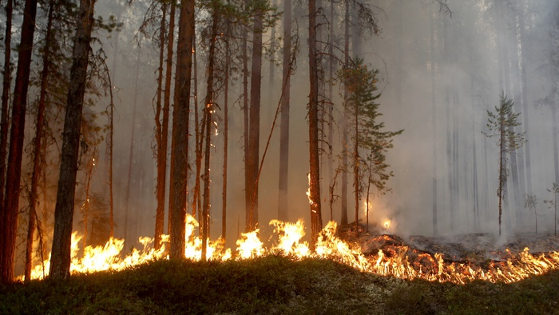
Sweden
Less snow and more rain in winter
Forest fires
What have we done?
We have a lot of carbon dioxide tax
Recycling
Public transportation
Try to eat more climate healthy
We can get money from the goverment so we can change our climate effect

Slide 3
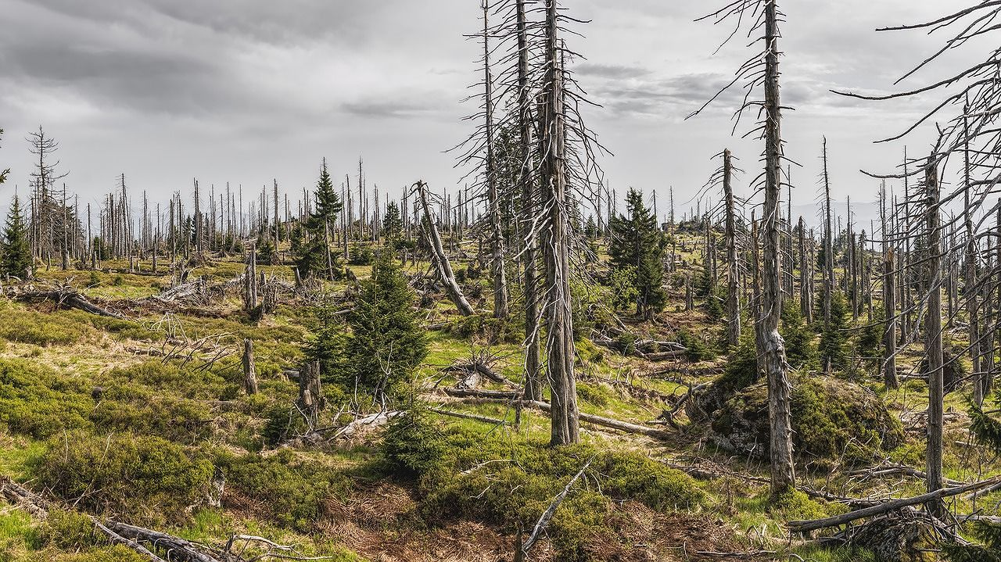
Germany
Less rain in summer
Less snow in winter
Black forest suffering
What have we done?
Carbon tax next year
Not allowed to drive diesel cars in Stuttgart
Public transportation

Slide 4
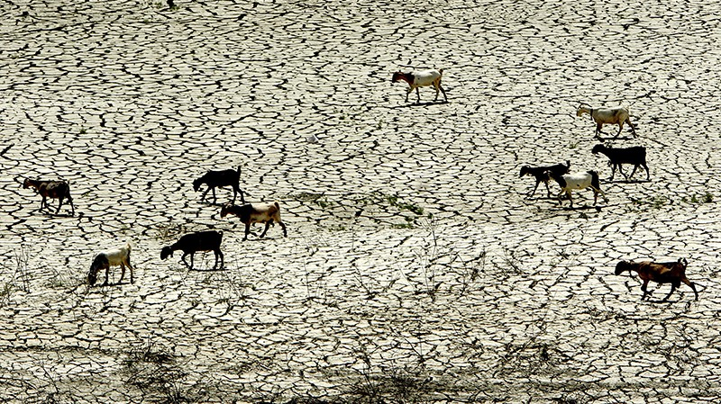
Cyprus
High temprature (reached 48 degrees)
Less rain in winter
Less wild animals
What have we done?
People try to recycle
Try to make people use bikes

Slide 5
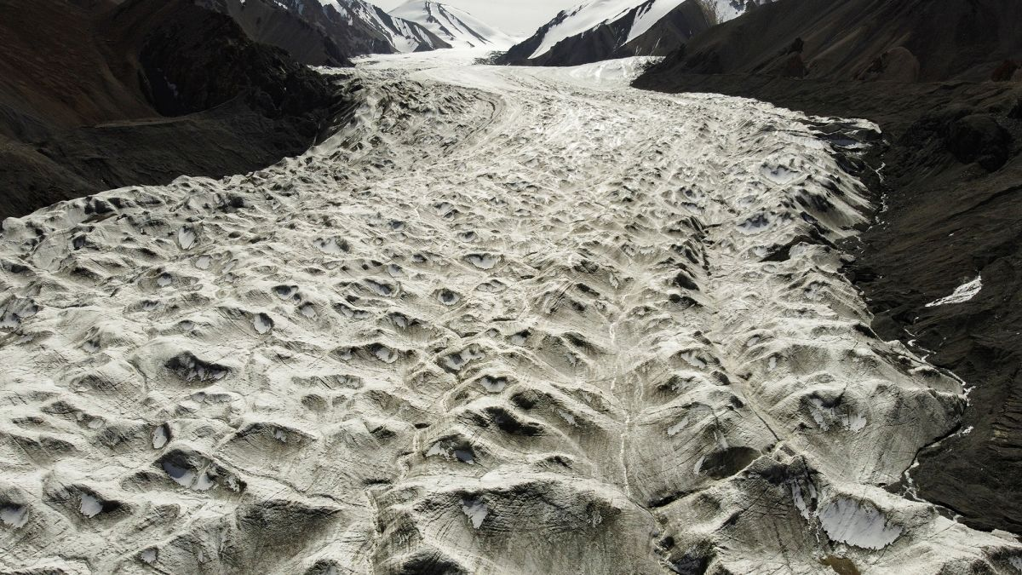
Italy
If it rains it comes very much (flooding)
Promoting sharing mobility
Glaciers are melting
What have we done?
Carbon tax

